Slide 1
About Anthropology
Basic Structure

Slide 3
ANP
Culture
Behavior
Archaeology
Biological

Slide 4
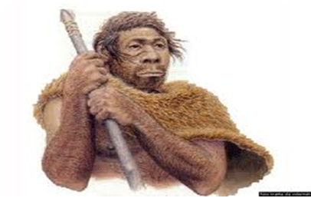
Homo Sapiens

Slide 5


